Slide 1
Intelligent Bone Fracture Detection System
Raveena Sivagurunathan (A0176727R)
Sneha More (A0297761M)
Swedha Rajarajan (A0297326U)
Rickson Hu Hong Rui (A0296664L)

Slide 2
Table of contents
01
02
03
04
05
06
Problem
Statement
Project
Overview
Data Preprocessing
Modelling and Results
Performance Evaluation
Conclusion

Slide 3
01
Problem Statement

Slide 4

The Growing Challenge of Elderly Bone Health in Singapore
Aging Nation, Rising Risk
By 2030, 1 in 4 Singaporeans will be aged 65+. WIth age comes fragility, bones weaken and fractures rise.
Diagnosis Delays = Danger
Manual X-ray inspection is time-consuming and prone to human error
The Bottleneck in Radiology
An explosion of imaging data is overwhelming radiologists, risking delayed treatment and poorer outcomes.

Slide 5



Can AI meet healthcare ?
AI is transforming the healthcare landscape by enhancing diagnostics , streamlining workflows, and empowering doctors to deliver faster , more accurate care.
AI is not just a tool, it is becoming a trusted assistant in the hands of medical professionals.

Slide 6
AI as an Assistant
Instant Analysis
High Precision
Effortless Scalability
AI scans and highlights potential fractures in real-time, enabling faster clinical decisions.
Deep learning models are trained to detect even the subtlest fracture lines.
AI can do heavy repetitive work by processing X-ray images without fatigue unlike humans.
No bias
Memory
A good model will ensure uniform diagnosis without any bias involved. Everyone receives equal service.
AI improves continuously with new data, offering sustainable accuracy gains and a lasting competitive edge.

Slide 7
Business Potential Beyond Diagnosis
Licensing to hospitals and clinics
Scalable for Private Healthcare and Telemedicine
Operational Efficiency
Packages as a SaMD ( Software as a Medical Device).
Reduce labor hours , shorten diagnosis time , improve patient turnover.
One time investment , model improves overtime

Slide 8
02
Project Overview

Slide 9



The Objective
To build deep learning models to detect types of fractures from X-Ray Images.
Compare apt deep learning models and lay down its advantages to the main goal → faster , accurate classification
Implement and compare the models through this experimental approach.
Note down further improvements

Slide 10
Battle of the Models
YOLO v8
Faster R-CNN
Real time Detection: Designed for ultra fast performance ,ideal for quick hospital workflows.
Lightweight & Deployable: Optimized for edge devices, cloud, or integrated PACS systems.
High Accuracy: Excels in detection precision, especially for subtle or complex fractures.
Two-Stage Architecture: Separates region proposals and classification for robust localization.

Slide 11
Pipeline Flow
Data Preprocessing
Model Training
Tuning
Model Evaluation
Model Performance

Slide 12
03
Data Preprocessing

Slide 13






Raw Data Collection & Preparation - Over 3,000+ unstructured X-ray images - Original annotations in COCO format
Image Resizing
- All images resized to 512×512 pixels
- Invalid or corrupted images removed
Data Splitting - Dataset split into 80% training / 20% validation
Data Augmentation
- Augmentations applied dynamically during training
Annotation Cleaning
- Bounding box coordinates scaled to resized images
- Cleaned and saved as structured JSON files
Handling Class Imbalance - Oversampling underrepresented fracture classes - Improved diversity of training samples for rare cases

Slide 14
04
Modelling and Results

Slide 15
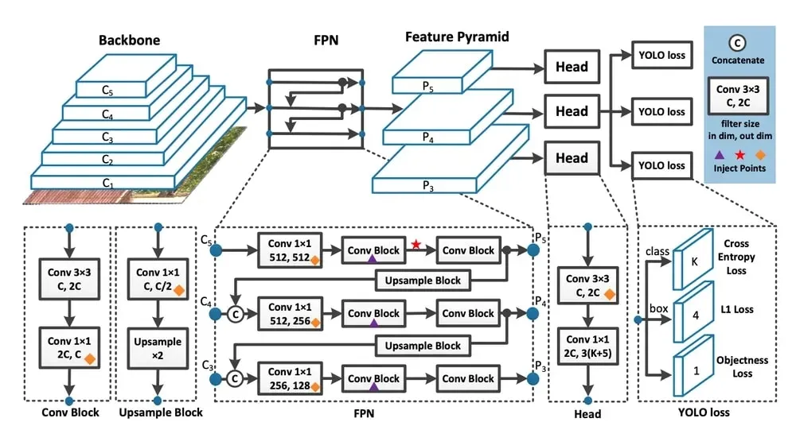
YOLOv8 - You Only Look Once
Unified Architecture
Supports detection and segmentation in one model
Speed and Accuracy
Fast real-time inference with strong precision
User-Friendly & Flexible
Simple API, easy training and broad deployment support

Slide 16
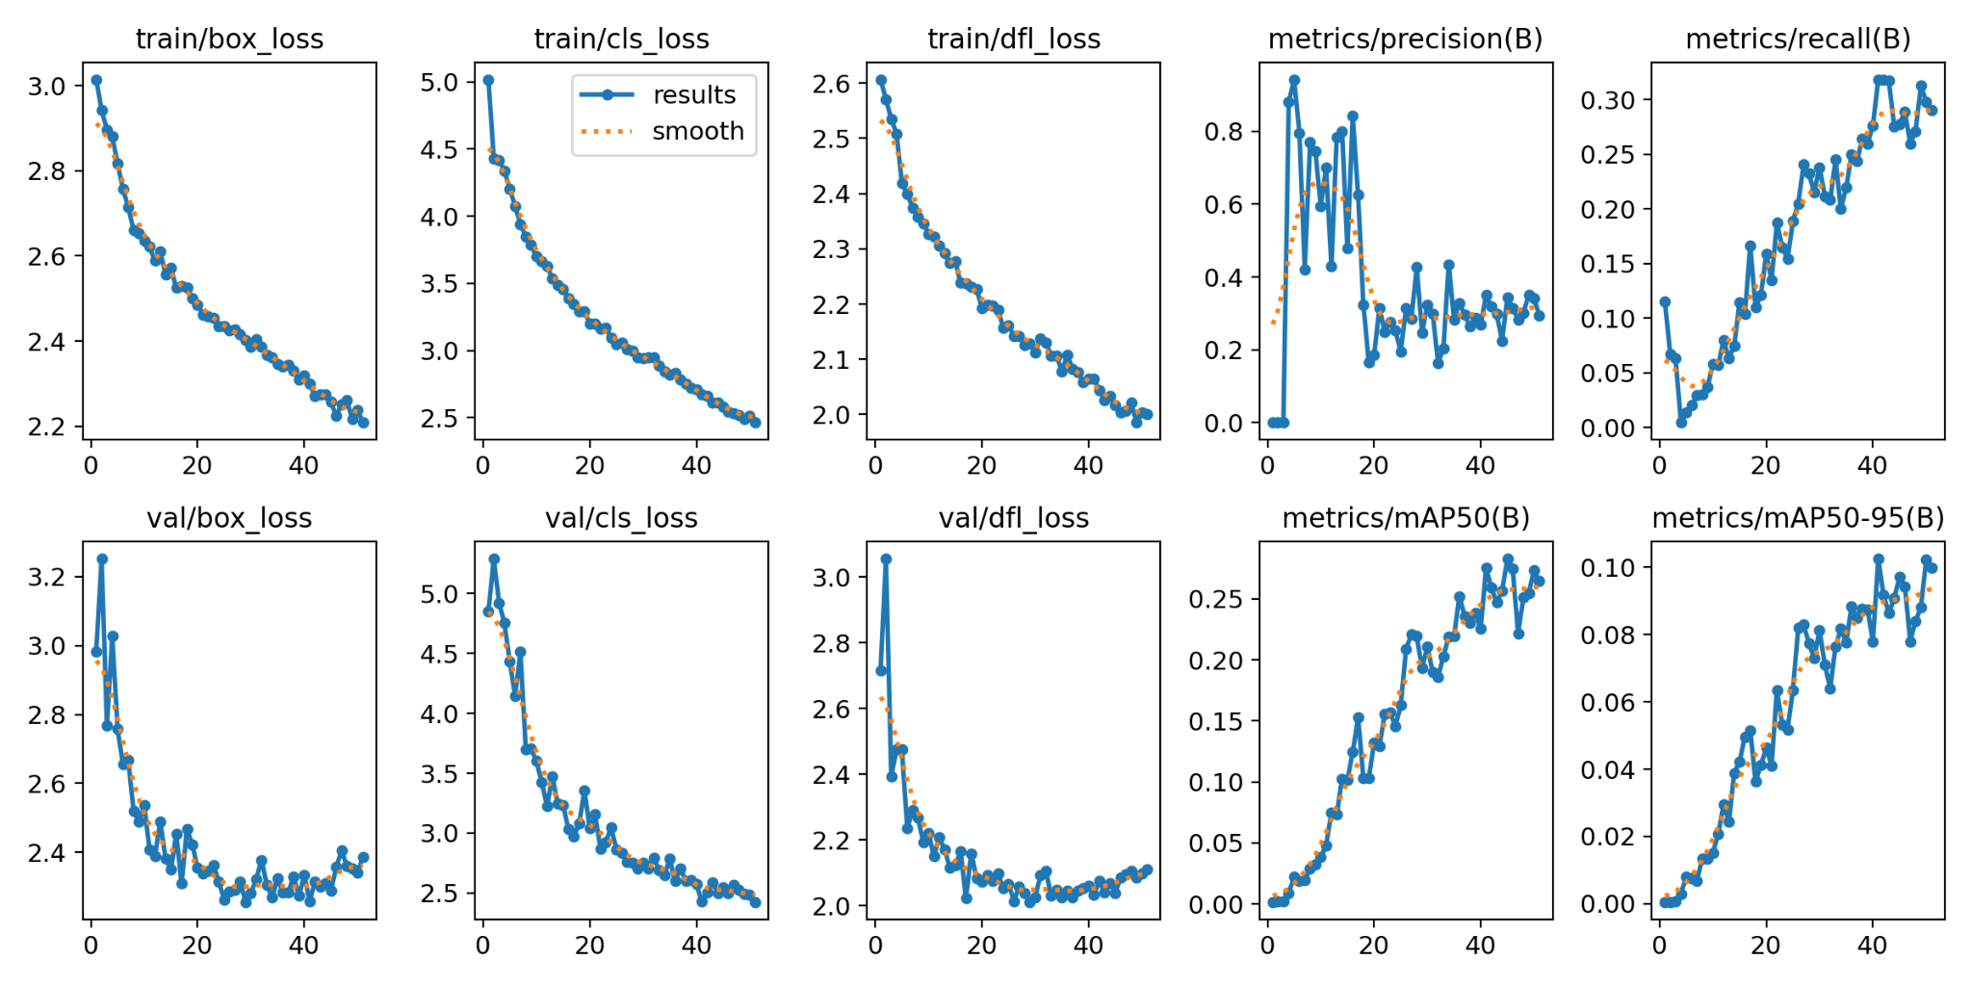
YOLOv8 Results
Localize and classify fractures effectively, without overfitting
Gradually learning to detect more true positives, but still missing some fractures
Performance is limited and not suitable for clinical application yet

Slide 17
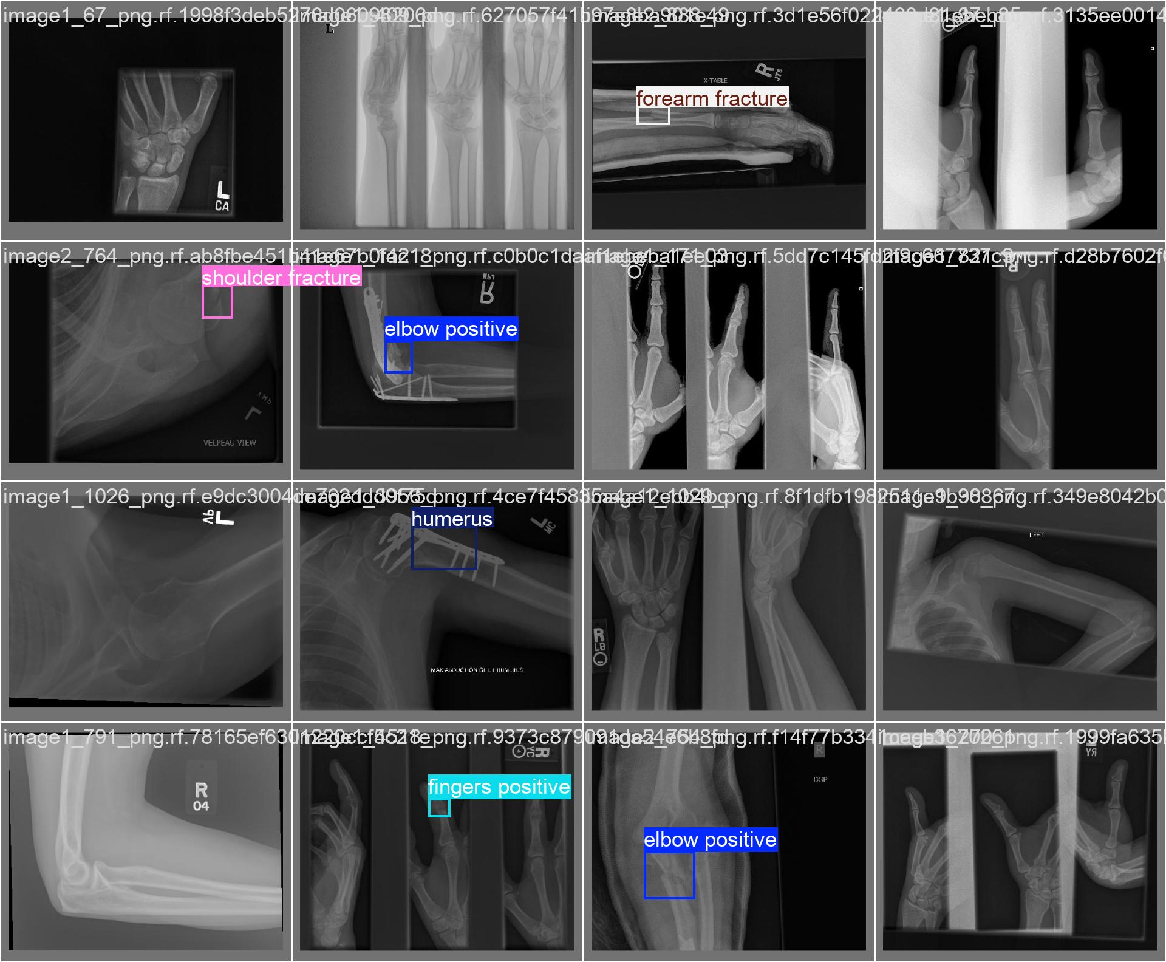
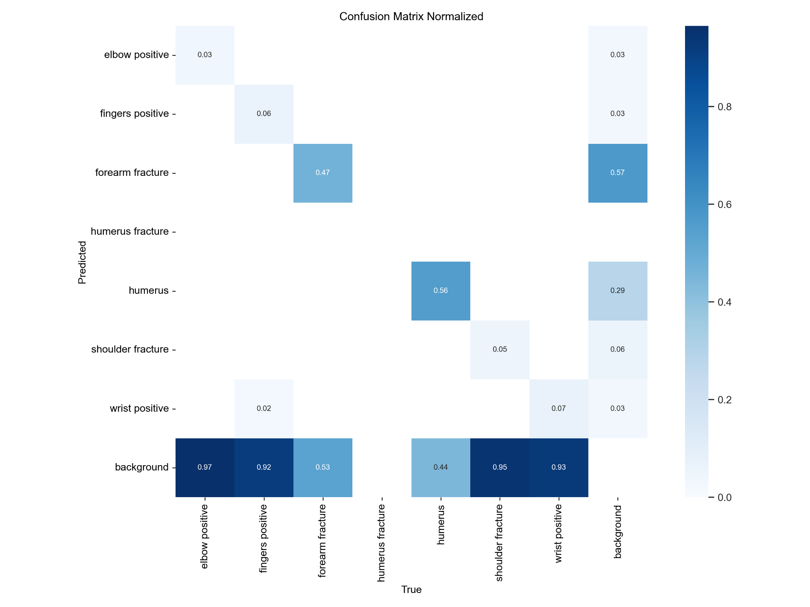
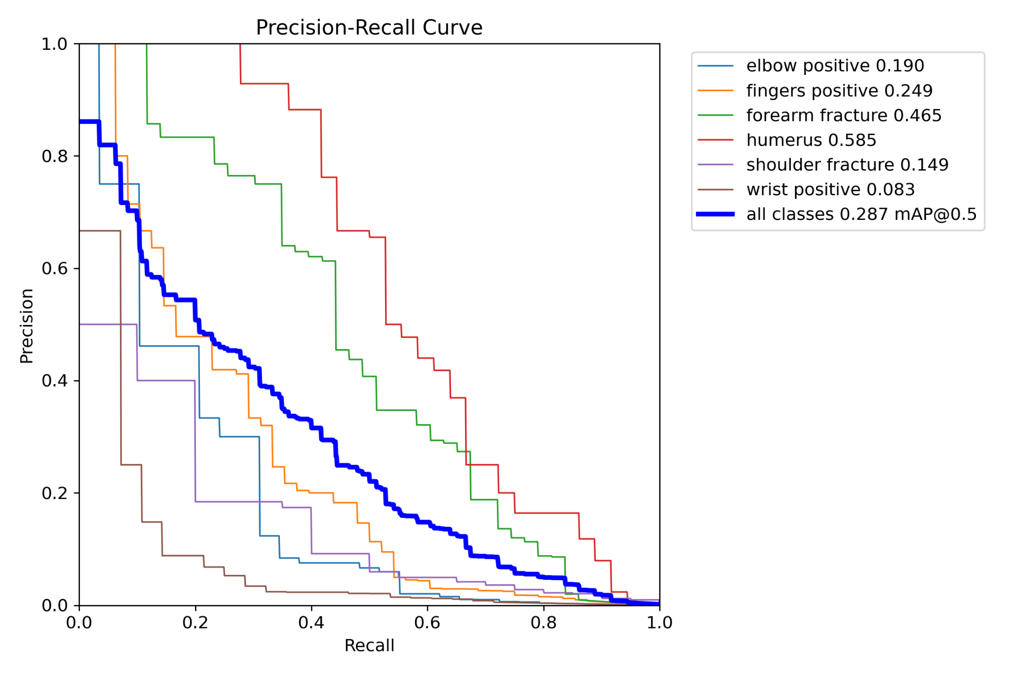
YOLOv8 Performance
Conservative prediction strategy
Overall strong performance with room for improvement
Precision is prioritized over recall to reduce false positives but may miss some true positive cases
High accuracy across classes with limited misclassification between fracture types

Slide 18
Faster-RCNN Model Overview
Built on Detectron2 with Faster-RCNN and ResNeXt-101-FPN backbone
Input: COCO-formatted dataset with resized 512×512 images
Custom dataset class created for handling augmentation and loading
Used Albumentations for image augmentation
Notes:
Let's begin with an overview of our approach.We implemented a Faster-RCNN model using Detectron2, specifically using the ResNeXt-101-32x8d backbone combined with a Feature Pyramid Network. This allowed us to extract strong multi-scale features — which is particularly important in medical imaging, where fractures can be small and subtle. Our dataset consisted of X-ray images annotated in the COCO format. All images were resized to 512 by 512 pixels, both for consistency and to reduce GPU load during training. We made sure to scale the bounding boxes accordingly to preserve label accuracy. To handle preprocessing and augmentation cleanly, we created a custom PyTorch dataset class. This allowed us to integrate augmentations seamlessly during training and retain full control over the input pipeline. We used the Albumentations library, which is optimized for image augmentation. Our training pipeline included a combination of horizontal flips, random brightness/contrast, rotations, and scaling — all designed to simulate variability in real-world X-ray imaging, such as different lighting conditions or patient orientations.

Slide 19
Model Configuration
Dataset registered using register_coco_instances()
Base config loaded from: COCO-Detection/faster_rcnn_ResNeXt-101-32x8d-FPN_3x.yaml
Trained for 3000 iterations using DefaultTrainer
Output directory logged using TensorBoard
Notes:
Now let’s move into how we configured the model using Detectron2’s modular pipeline. We started by registering our dataset using the function register_coco_instances() — this let Detectron2 know where to find our images and annotations for both the training and validation sets. Then we imported a pretrained config from Detectron2’s model zoo: COCO-Detection/faster_rcnn_ResNeXt-101-32x8d-FPN_3x.yaml. This config already includes sensible defaults like anchor sizes, learning rates, and the structure of the Region Proposal Network, which we fine-tuned to our dataset. We trained the model for 3000 iterations using Detectron2’s DefaultTrainer. This took care of data loading, augmentation, logging, optimization, and checkpointing. To monitor the model’s performance, we used TensorBoard, which logged metrics like total loss, classification loss, and bounding box regression loss. This made it easy to visualize and debug training in real time.

Slide 20
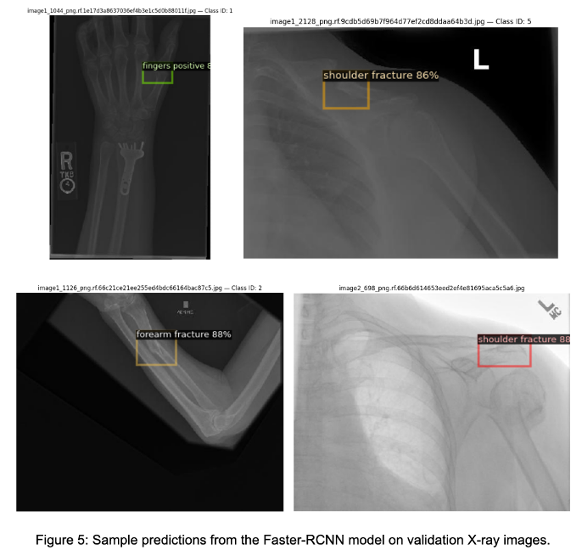
Sample Predictions
Key Points:
Model detects fractures with high confidence:
Forearm (88%)
Shoulder (86%–88%)
Fingers (81%)
Missed some subtle fractures (e.g., elbow)
Notes:
This slide shows some of the actual predictions made by our trained model on the validation set. Each image highlights predicted bounding boxes with their corresponding class labels and confidence scores. The model was able to detect: Forearm fractures with 88% confidence, Shoulder fractures at 86% and 88%, and A fingers-positive case with 81%. These results show that the model can accurately detect larger and clearer fractures, especially when the contrast in the X-ray is high or when the bone structure is well isolated. However, we also noticed a few missed detections, especially for elbow and wrist areas. These subtle fractures were either completely missed or fell below the confidence threshold. This may be due to underrepresentation in the dataset or the model being overly conservative in cases of ambiguity.

Slide 21
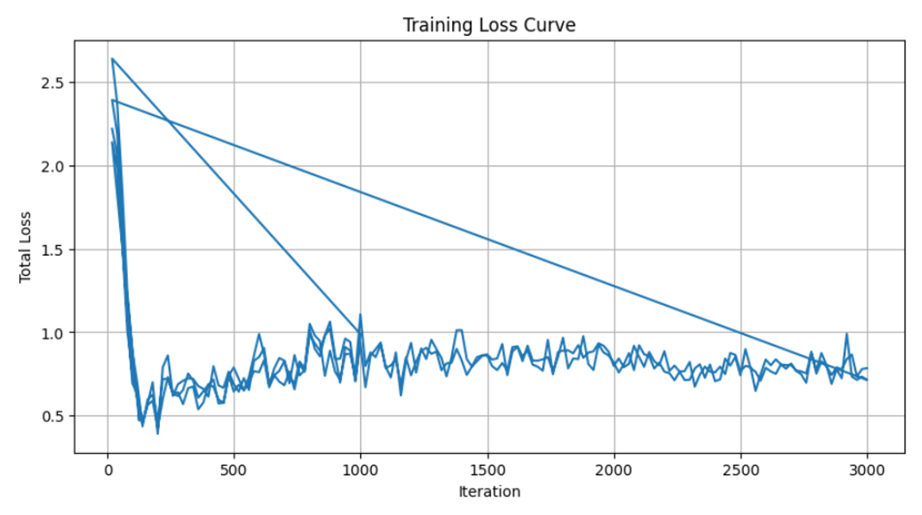
Training Loss Curve
Key Points:
Rapid drop in total loss within first 500 iterations
Stabilization after 1000 iterations
Slight overfitting beyond 2500 iterations
Notes:
Here, we have the training loss curve, logged via TensorBoard. At the start of training, the total loss dropped very rapidly within the first 500 iterations. This tells us the model learned basic spatial and class separation patterns very quickly. Between 500 to 2000 iterations, the loss continued to stabilize and fluctuate within a tighter range, which is typical of a model that is converging and refining its predictions. However, we did observe some minor oscillations after iteration 2500. This could be early signs of overfitting, where the model starts to memorize patterns in the training set instead of generalizing. That said, the final loss values stayed in a reasonable band, and the model did not collapse — so we considered the training run successful and stopped it at 3000 iterations

Slide 22
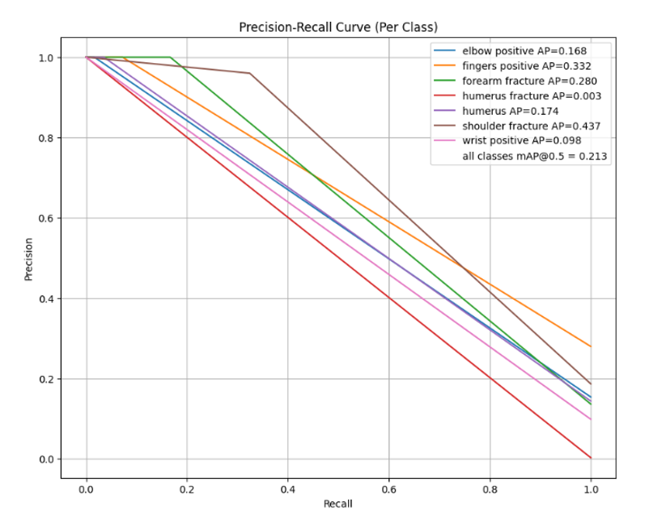
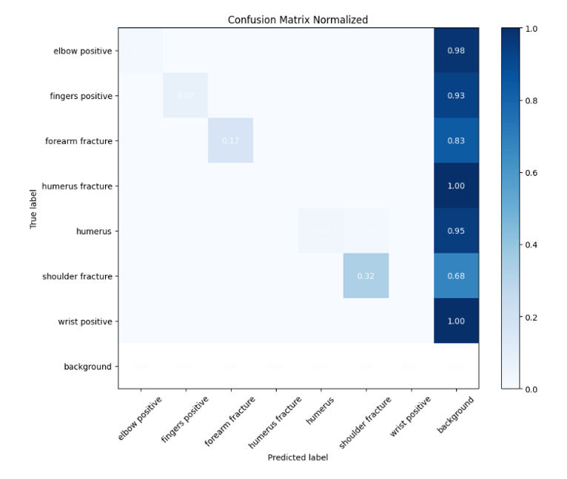
Evaluation – Metrics
Key Points:
mAP@0.5 ≈ 0.34; mAP@[0.5:0.95] ≈ 0.10
Confusion matrix: shoulder/forearm misclassified often
PR Curve shows:
Shoulder: AP = 0.437
Elbow: AP = 0.033
Wrist: AP = 0.098
Indicates strong precision, but recall still weak for subtle classes
Notes:
Finally, let’s look at how the model performed quantitatively. We evaluated it using COCO-style metrics, which include mean Average Precision at different Intersection over Union thresholds. The model achieved: A mAP@0.5 of about 0.34, which reflects reasonable accuracy for bounding box overlap, And a more stringent mAP@0.5–0.95 of around 0.10, highlighting room for improvement in tight localization. Looking at the confusion matrix, we can see that the model performs well for certain classes like humerus and wrist positive, but struggles to distinguish shoulder from forearm fractures. This makes sense anatomically, as those regions can be similar in appearance. The precision-recall curves further support this observation: Shoulder fracture had the highest AP at 0.437, Elbow had very low AP at just 0.033, Wrist was also weak at 0.098. These results tell us that the model is quite precise when it makes a detection, but it’s not great at catching all positives — especially for subtle or ambiguous fractures. So going forward, we’re planning to: Increase the number of training examples for rare classes, Experiment with class-aware augmentation or focal loss, and Explore transformer-based detection methods like DETR, which may perform better on small object detection in medical settings.

Slide 23
05
Performance Evaluation

Slide 24
Model Comparison
Key Points:
Metric | YOLOv8 | Faster R-CNN
mAP at 0.5 | 0.287 | 0.34
mAP at 0.5-0.95 | 0.10 | 0.10
Precision | 0.30 | 0.42
Recall | 0.31 | 0.51
Notes:
Finally, let’s look at how the model performed quantitatively. We evaluated it using COCO-style metrics, which include mean Average Precision at different Intersection over Union thresholds. The model achieved: A mAP@0.5 of about 0.34, which reflects reasonable accuracy for bounding box overlap, And a more stringent mAP@0.5–0.95 of around 0.10, highlighting room for improvement in tight localization. Looking at the confusion matrix, we can see that the model performs well for certain classes like humerus and wrist positive, but struggles to distinguish shoulder from forearm fractures. This makes sense anatomically, as those regions can be similar in appearance. The precision-recall curves further support this observation: Shoulder fracture had the highest AP at 0.437, Elbow had very low AP at just 0.033, Wrist was also weak at 0.098. These results tell us that the model is quite precise when it makes a detection, but it’s not great at catching all positives — especially for subtle or ambiguous fractures. So going forward, we’re planning to: Increase the number of training examples for rare classes, Experiment with class-aware augmentation or focal loss, and Explore transformer-based detection methods like DETR, which may perform better on small object detection in medical settings.

Slide 25
06
Conclusion

Slide 26
Project Highlights
Developed an AI-powered system for automated bone fracture detection using YOLOv8 and Faster R-CNN.
Preprocessing pipeline ensured consistent, clean data and improved model robustness.
YOLO v8: Fast inference, moderate accuracy — suitable for real-time hospital workflows.
Models showed promise but require enhancements for clinical readiness.
Notes:
Let's begin with an overview of our approach.We implemented a Faster-RCNN model using Detectron2, specifically using the ResNeXt-101-32x8d backbone combined with a Feature Pyramid Network. This allowed us to extract strong multi-scale features — which is particularly important in medical imaging, where fractures can be small and subtle. Our dataset consisted of X-ray images annotated in the COCO format. All images were resized to 512 by 512 pixels, both for consistency and to reduce GPU load during training. We made sure to scale the bounding boxes accordingly to preserve label accuracy. To handle preprocessing and augmentation cleanly, we created a custom PyTorch dataset class. This allowed us to integrate augmentations seamlessly during training and retain full control over the input pipeline. We used the Albumentations library, which is optimized for image augmentation. Our training pipeline included a combination of horizontal flips, random brightness/contrast, rotations, and scaling — all designed to simulate variability in real-world X-ray imaging, such as different lighting conditions or patient orientations.

Slide 27
Next Steps & Vision Forward
Next steps:
Vision:
Enhance data augmentation for rare fracture types and complex cases.
Refine loss functions to improve sensitivity and accuracy.
Experiment with ensemble approaches and advanced architectures (e.g., transformers).
Streamline hospital diagnostics and enable faster, AI-supported decision-making.
Reduce workload on radiologists by automating initial fracture screening.
Ensure faster patient interventions, improving treatment timelines.
Build a self-learning system that continuously improves with new medical data.

Slide 28




Thanks!

